Slide 1
Measuring Malaria in Complex Transmission Systems
Alec Georgoff
May 18, 2018

Slide 2
Background
Ross-Macdonald Model
Simplest basic model of transmission
“Theoretical scaffolding” of a malaria transmission model
Basic Reproductive Number (R₀)
R₀ > 1 → Transmission sustained (endemic)
R₀ < 1 → Transmission will die out
Forest Malaria
Major problem in GMS
Unique transmission landscape

Slide 3
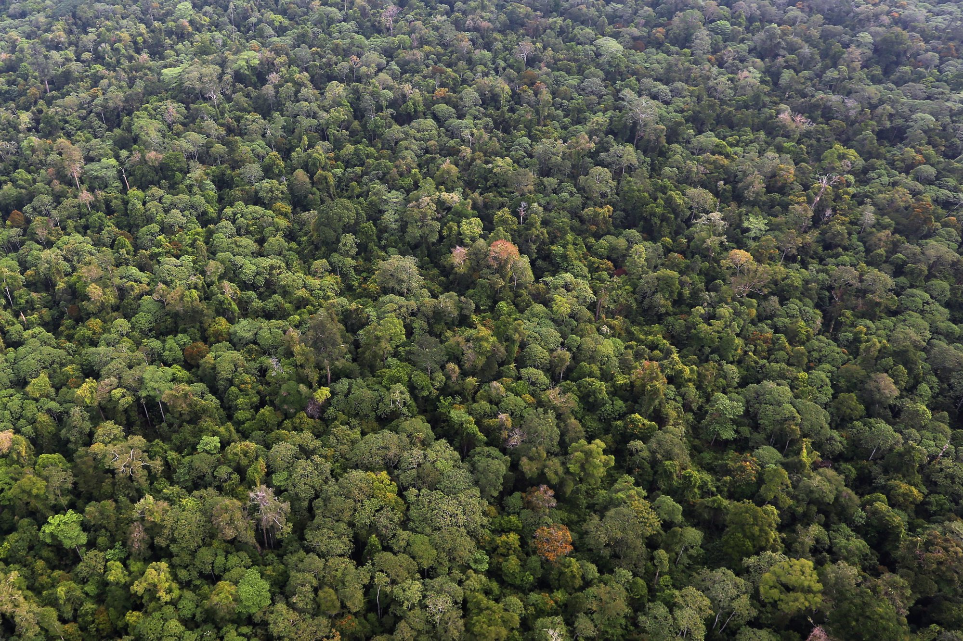
Forest Malaria
Village
Village
Village

Slide 4
Forest Malaria – Simplified System
Simplify to one village & one forest
Village

Slide 5
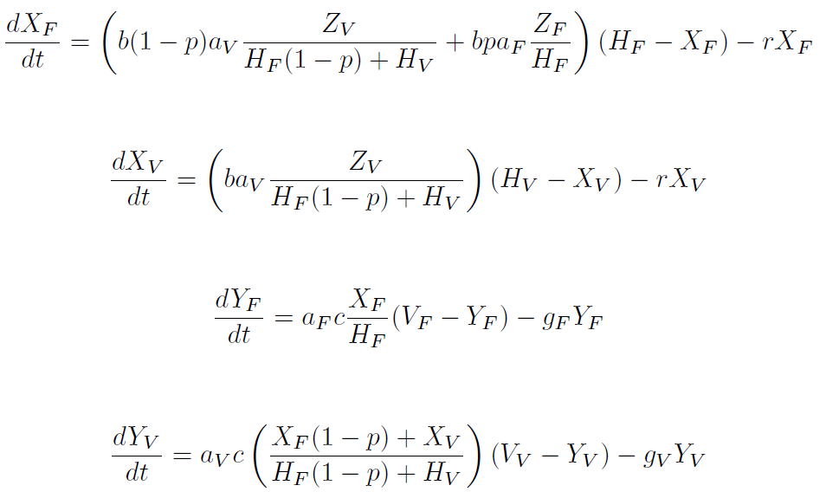
Forest Malaria – Simplified System
System governed by four ODEs:
Infected Humans (Forest):
Infected Humans (Village):
Infected Mosquitoes (Forest):
Infected Mosquitoes (Village):

Slide 6
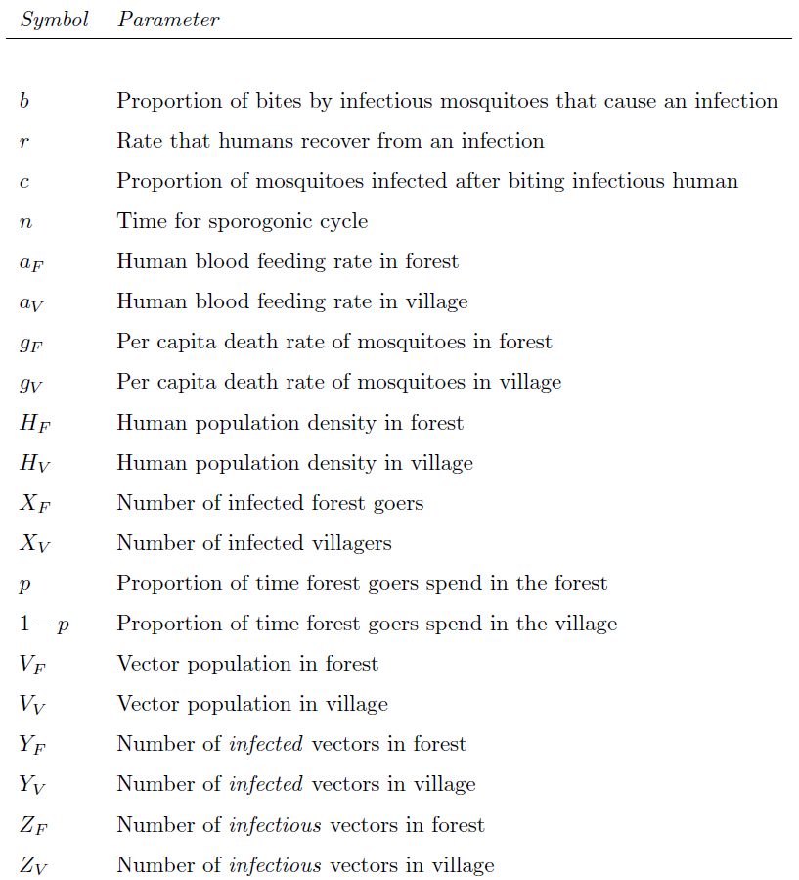
Forest Malaria – Simplified System

Slide 7
Forest Malaria – Simplified System

Slide 8
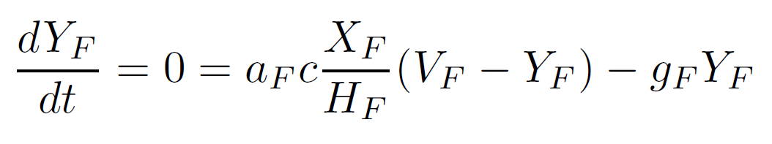
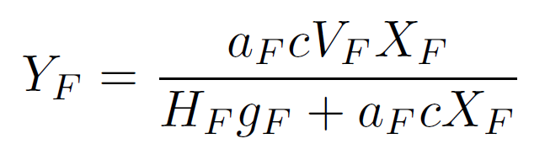
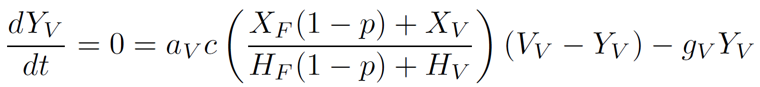
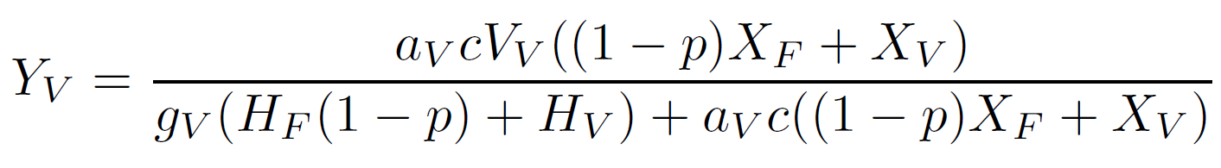
Assume Equilibrium Mosquito Populations

Slide 9
Assume Equilibrium Mosquito Populations

Slide 10
Assume Equilibrium Mosquito Populations

Slide 11
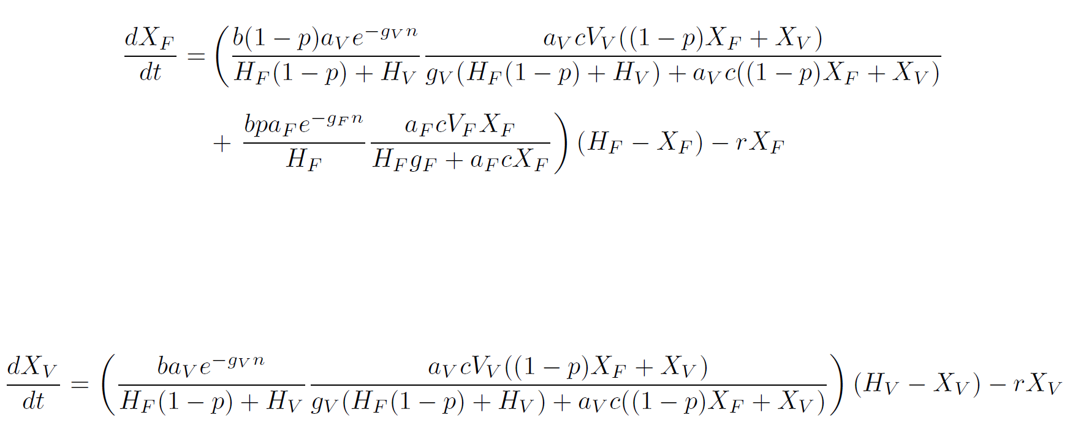
Insert Mosquito Populations Into Human Equations

Slide 12
Insert Mosquito Populations Into Human Equations

Slide 13
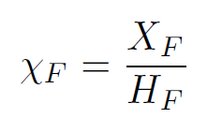
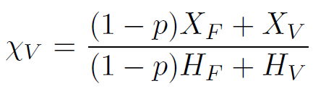
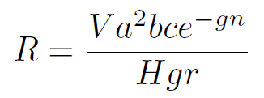
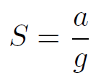
Simplify Equations
Additional Parameters:
Prevalence

Slide 14
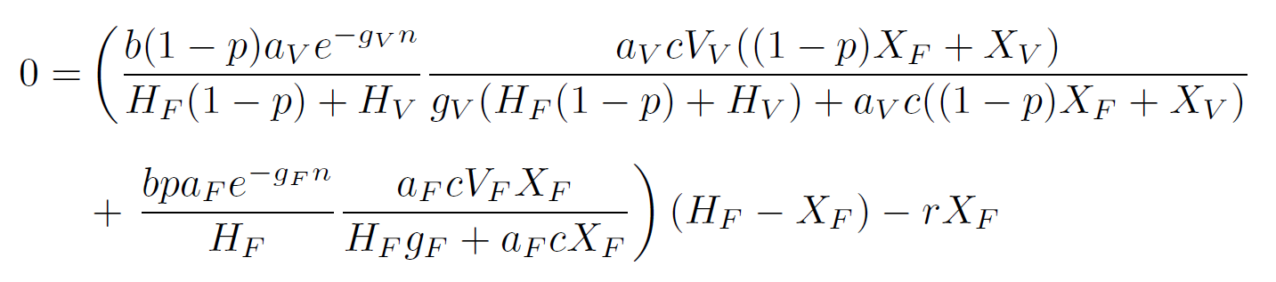
Simplify Equations

Slide 15
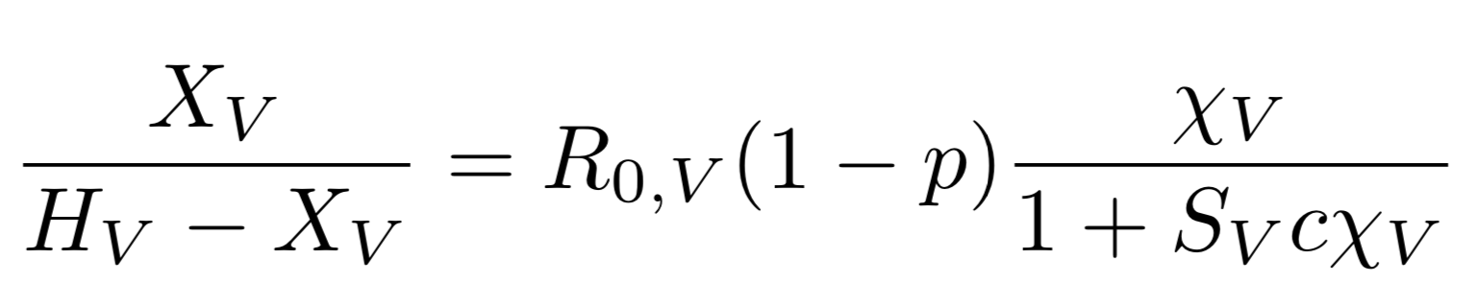
Simplify Equations

Slide 16
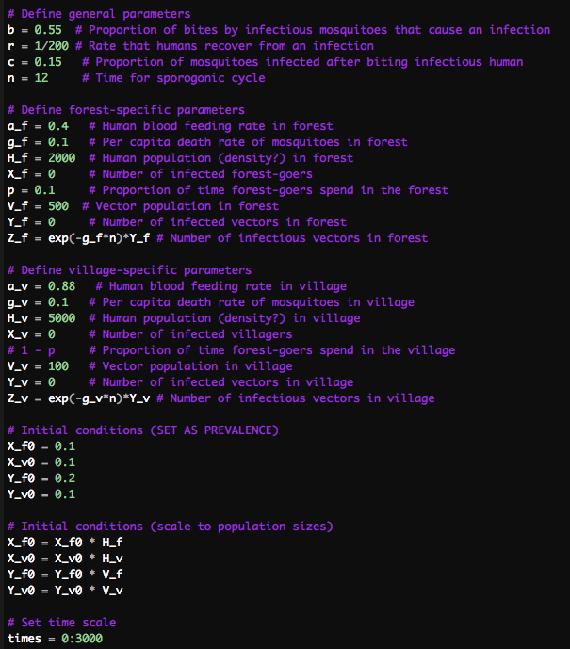
Model in R

Slide 17
Model in R

Slide 18
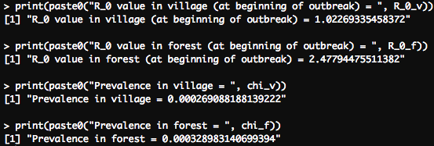
Model in R
R values are not reasonable
Need to figure out why…

Slide 19
What We’re Hoping to Find
R_{0,F}
1
1
R_{0,V}

Slide 20
What We’re Hoping to Find
R_{0,F}
Persists
Persists
1
Persists
1
R_{0,V}

Slide 21
What We’re Hoping to Find
R_{0,F}
Persists
Persists
1
Persists
Dies Off
Persists
1
R_{0,V}

Slide 22
Next Steps
Figure out how to accurately calculate R values
(Potentially) convert to matrix operations
See if we can actually produce that graph
Sensitivity analysis (?)

